Slide 1
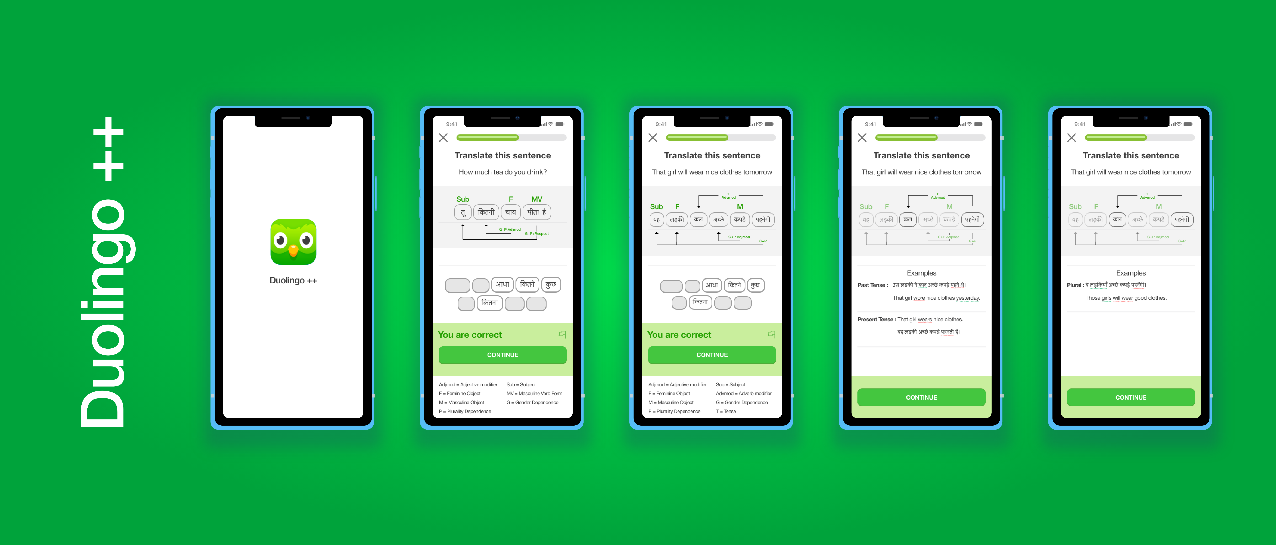
Interactive Dependency Visualization for deeper language understanding
Jaidev Shah
Computer Science, Columbia SEAS 2021

Slide 2
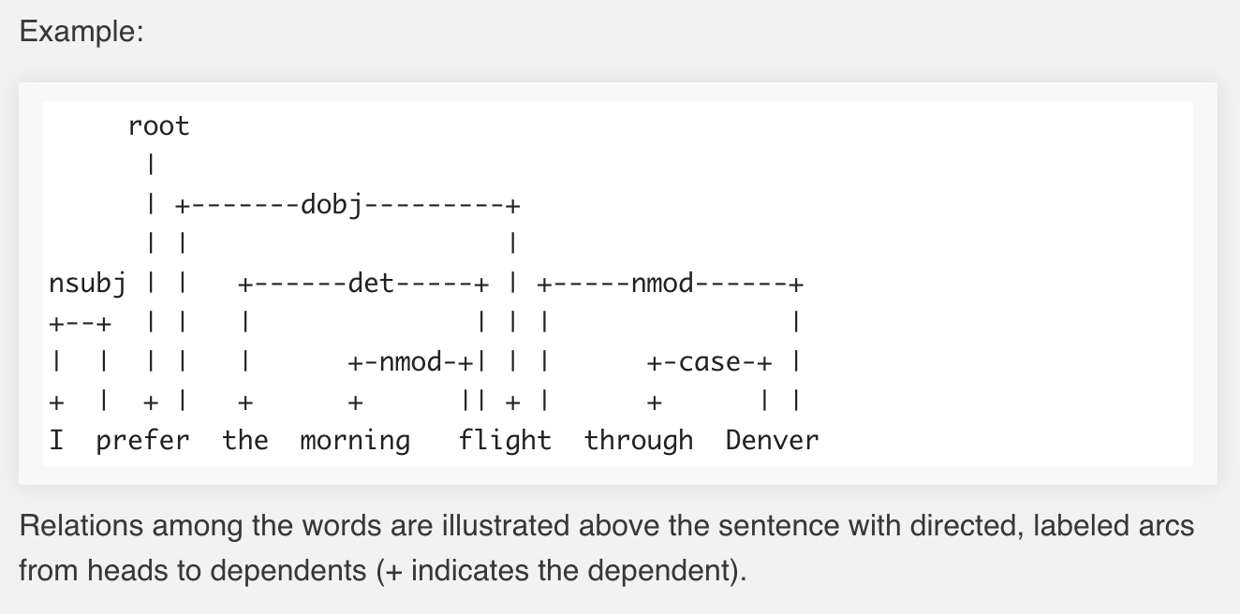
Motivation
KPI: Average user learning rate on sentence formation and translation tasks
Different languages can have significantly different dependency structures. Being able to visualize dependencies in a sentence is a more intuitive and native way to learn a new language rather than always trying to map the translation to the foreign language sentence and trying to infer these dependencies. With the feature of interactively visualizing these dependencies during sentence formation and translation tasks on Duolingo, I believe users will be able to learn faster and retain a more comprehensive understanding of the language.
How to achieve this visualization? In Natural Language Processing, “Dependency parsing is the task of extracting a dependency parse of a sentence that represents its grammatical structure and defines the relationships between head words and words, which modify those heads.”
In fact, English has a relatively easy dependency structure. Languages like Hindi or Spanish often have more long-distance dependencies (As an example in Hindi, Verb form also depends gender of noun, as well as degree of respect conferred to the noun). Certain words in a sentence can also affect tense.

Slide 3
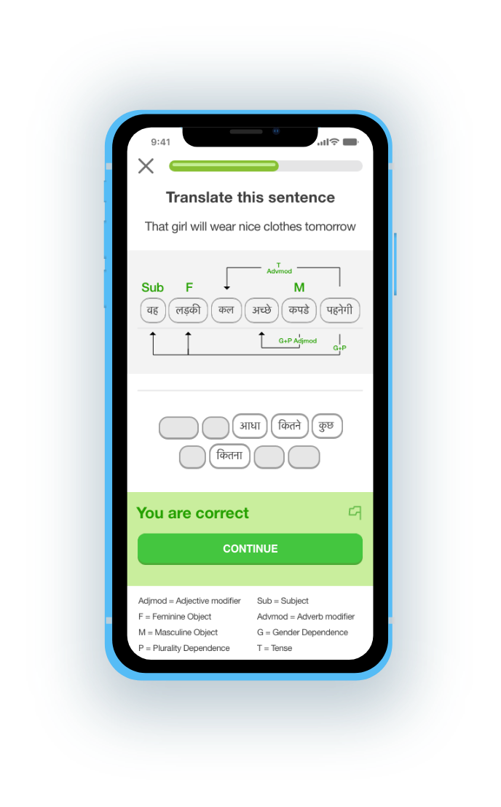
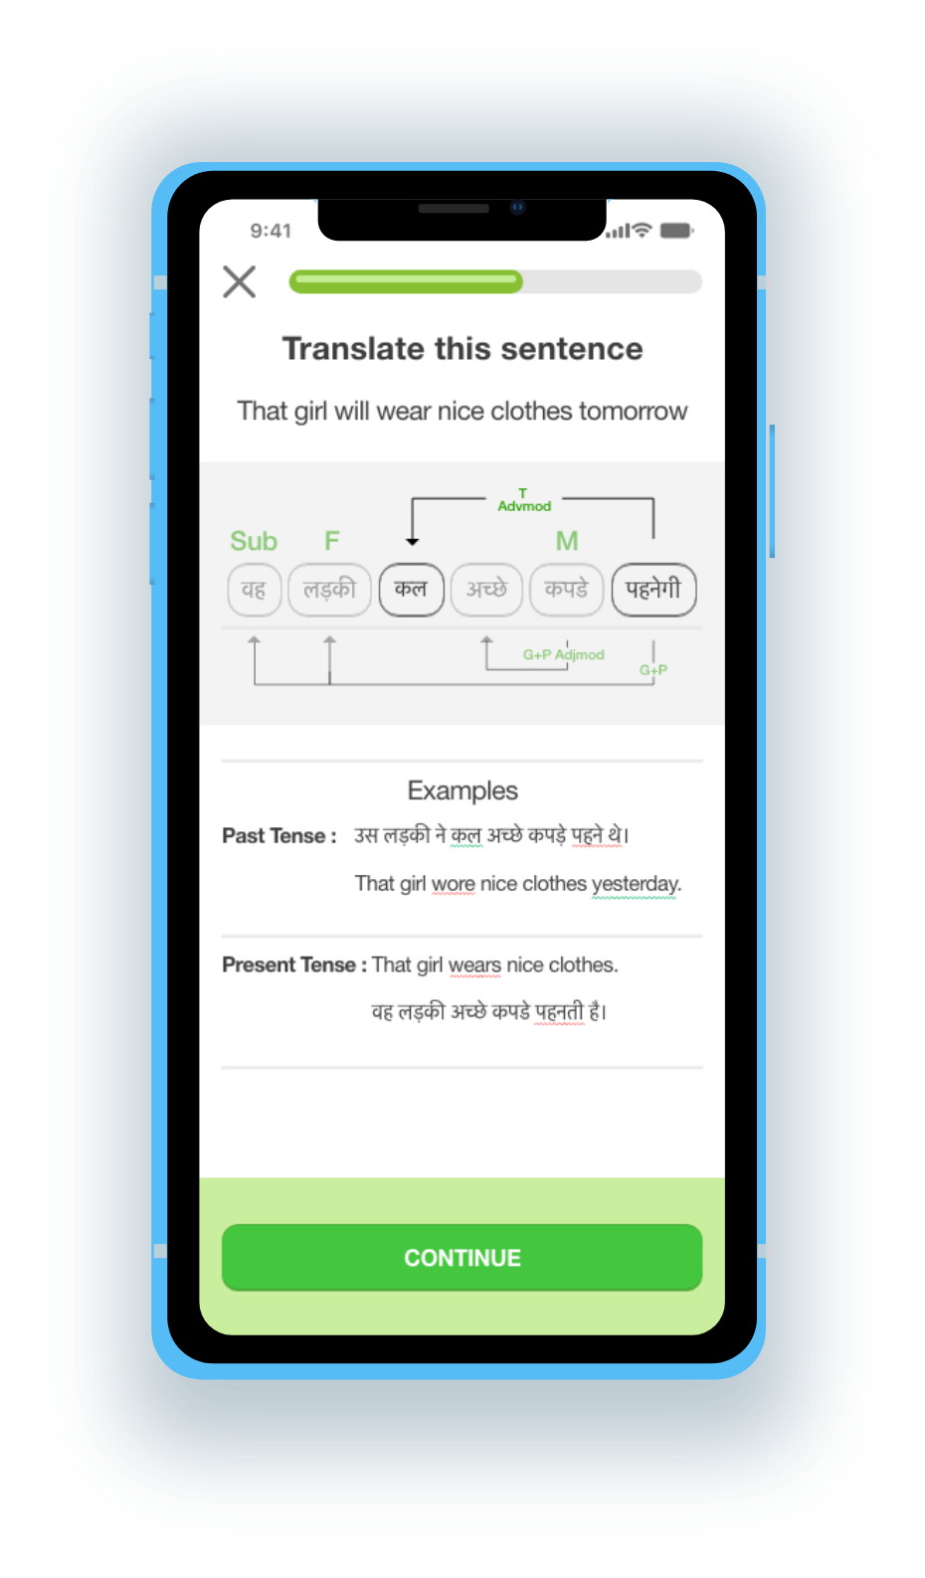
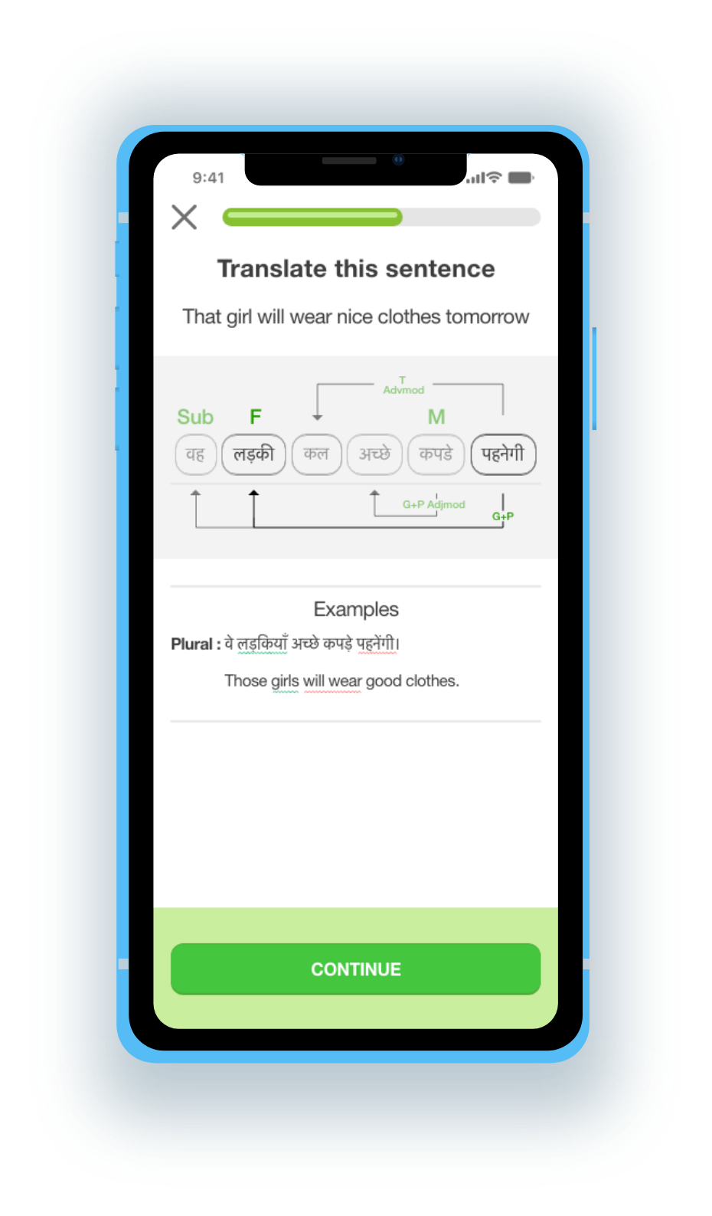
Initial visualization:
All non-trivial dependencies
User clicks on the Tense dependency arrow
User clicks on the Plurality dependency arrow
1
World’s largest coral reef system
2
Can be seen from outer space
3
Located in Queensland, AU

Slide 4
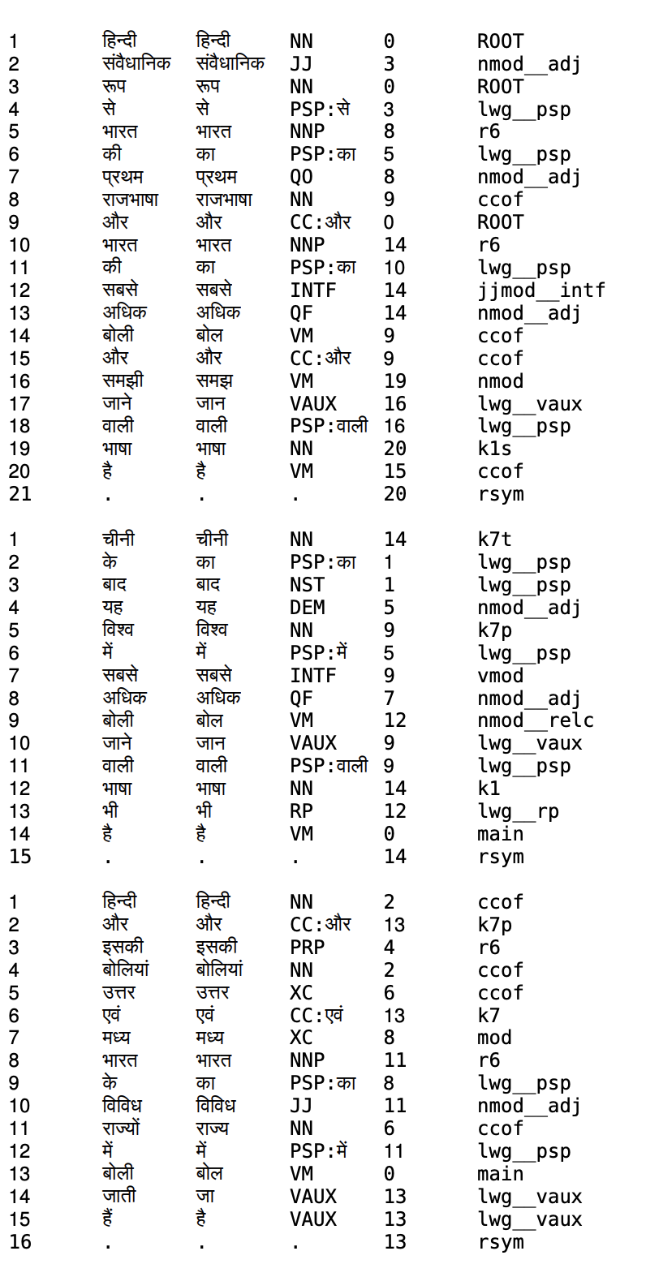
Technical detail
There exist reasonably accurate dependency parsers for most languages.
For displaying examples for each dependency arrow, we would generate examples by iterating through different versions of that dependency.
However, we will only be displaying the more important language-specific dependency arrows.
http://sivareddy.in/papers/files/hindi.dependency.parser.out.pdf
Source Code (Hindi Dependency Parser)
https://bitbucket.org/sivareddyg/hindi-dependency-parser/src/master/

Slide 5
User actions for tracking and analysis
Hypothesis Validation
Hypothesis: Providing interactive dependency visualizations in sentence formation/ translation tasks on Duolingo will accelerate average user learning rate. (essentially, quality of understanding over quantity of tasks solved)
Before building the feature, running tests on focus groups and obtaining data on how long, while being shown examples one after the other, it takes them to get a particular kind (i.e. encodes a specific non-trivial dependency) of foreign language translation correct most of the time (above some accuracy threshold close to those of native speakers). We’d compare insights from this data with those obtained by running the same test, but this time also displaying the dependency visualizations. If the jump in learning rate is significant, the ROI on such a feature could definitely be justified.
To measure the effectiveness of the feature, there are a couple user actions we can track and use as metrics. We would release the new feature in a small but diverse set of users for testing, and compare accuracy metrics between the two pools.
Furthermore, we would want to track the number of times user’s use the optional ability to click the dependency arrows and see the example set screen. This tells us what fraction of users find the interactive visualization helpful enough to keep on using it to view examples.
1
World’s largest coral reef s
2
3

